Slide 1
Emerson in the Energy Sector
Stephen C. Hassell
President, Avocent
17 August 2012

Slide 2
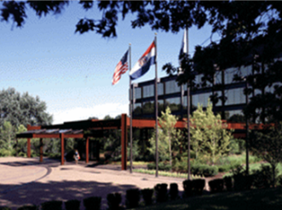
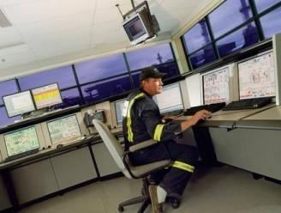
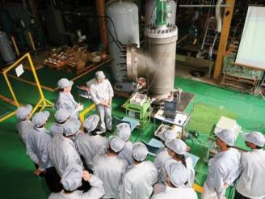
Emerson At-a-Glance 2011
US $24.2 Billion in Sales
2
2
Headquarters in St. Louis, Missouri USA
NYSE: EMR
Diversified global manufacturer and technology provider
Approximately 133,000 employees worldwide
Manufacturing and/or sales presence in more than 150 countries
235 manufacturing locations around the world
No. 120 on 2011 FORTUNE 500 list of America’s largest corporations
Founded in 1890
Member of The Green Grid since 2007 and board member since 2010
2

Slide 3
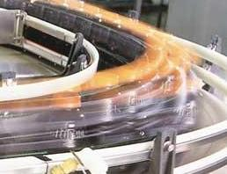
Emerson is a Leader in Its Core Global Businesses & Markets
#1 AC & DC Power Systems
#1 OEM Embedded Power
#1 Precision Cooling Systems
#1 Access & Control (KVM)
#1 Power Switching & Controls
#1 Control Valves
#1 Measurement Devices
#1 Wireless Devices
#1 Compressors
#1 Controls
#1 Alternators
#1 Fluid Control
#1 Ultrasonic Welding
#1 Food Waste Disposers
#1 Residential Storage Solutions
#1 Mobile Point-of-Care Carts
#1 Plumbing Tools
#1 Wet/Dry Vacuums
#1 Pressing Tools/Jaws
#1 CCTV Inspection Systems
NOTE: Numbers represent position in market.
3

Slide 4
2010 Total U.S. Energy Consumption
Other
Other
Lighting
Other
HVAC
Lighting
Electro-Chemical
Processes
Laundry
Cooking
Machine Drives
Appliances
Lighting
Process Cooling
& Refrigeration
Electronics
Pumps
Water Heater
Process
Heating
Heating
Water Heater
Refrigeration
HVAC
Office Equip.
Boilers
Cooling
Emerson Participation
Source: EIA 2010 Annual Energy Outlook and 2006 Manufacturer Energy Consumption Survey

Slide 5
Emerson Network Power Enabling Business-Critical Continuity™
2011 Revenue: US $6.8B
5

Slide 6
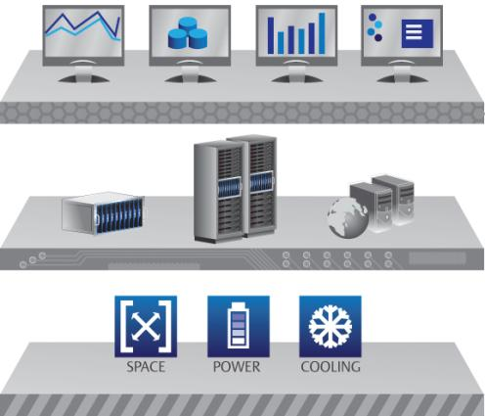
Traditional Data Center Approach
Logical
Layer
IT
Physical Layer
DCIM Tools
Context of
space, power
& cooling
Traditional Silo
Facilities
Physical Layer
6

Slide 7
Infrastructure Imperatives
Compliance
& Security
Capacity
& Agility
Availability
Operate
Design
Efficiency & Cost
7

Slide 8
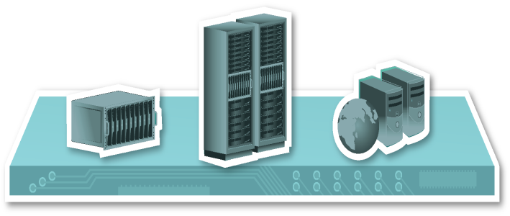
Traditional Solution : Add Buffer To Increase Availability
Data Center Power Allocation
According to Emerson calculations, if every U.S. data center could utilize 10% MORE of their CAPACITY, the need to build more than 2 million square feet of new data center space could be eliminated each year . . . . SAVING MORE THAN $10B
Actual Capacity
Buffer Limit
Dynamic Changes
Power
Stranded Capacity
Power Usage
Dynamic Changes
Time
“Data center power capacity includes buffers intended to absorb spikes in power use caused by peaks in resource utilization. These buffers are typically based on either nameplate or nominal server power consumption or power consumption measured at peak utilization with specific workloads.”
Space
Power
Cooling
Static
Source: Intel White Paper - Increasing Data Center Efficiency with Server Power Measurements
8

Slide 9
Autonomic Nervous System
Rapidly processes information
Automatically adjusts to environment
Gathers inputs from multiple sources
Actions happen both involuntarily and in tandem with conscious mind
9

Slide 10
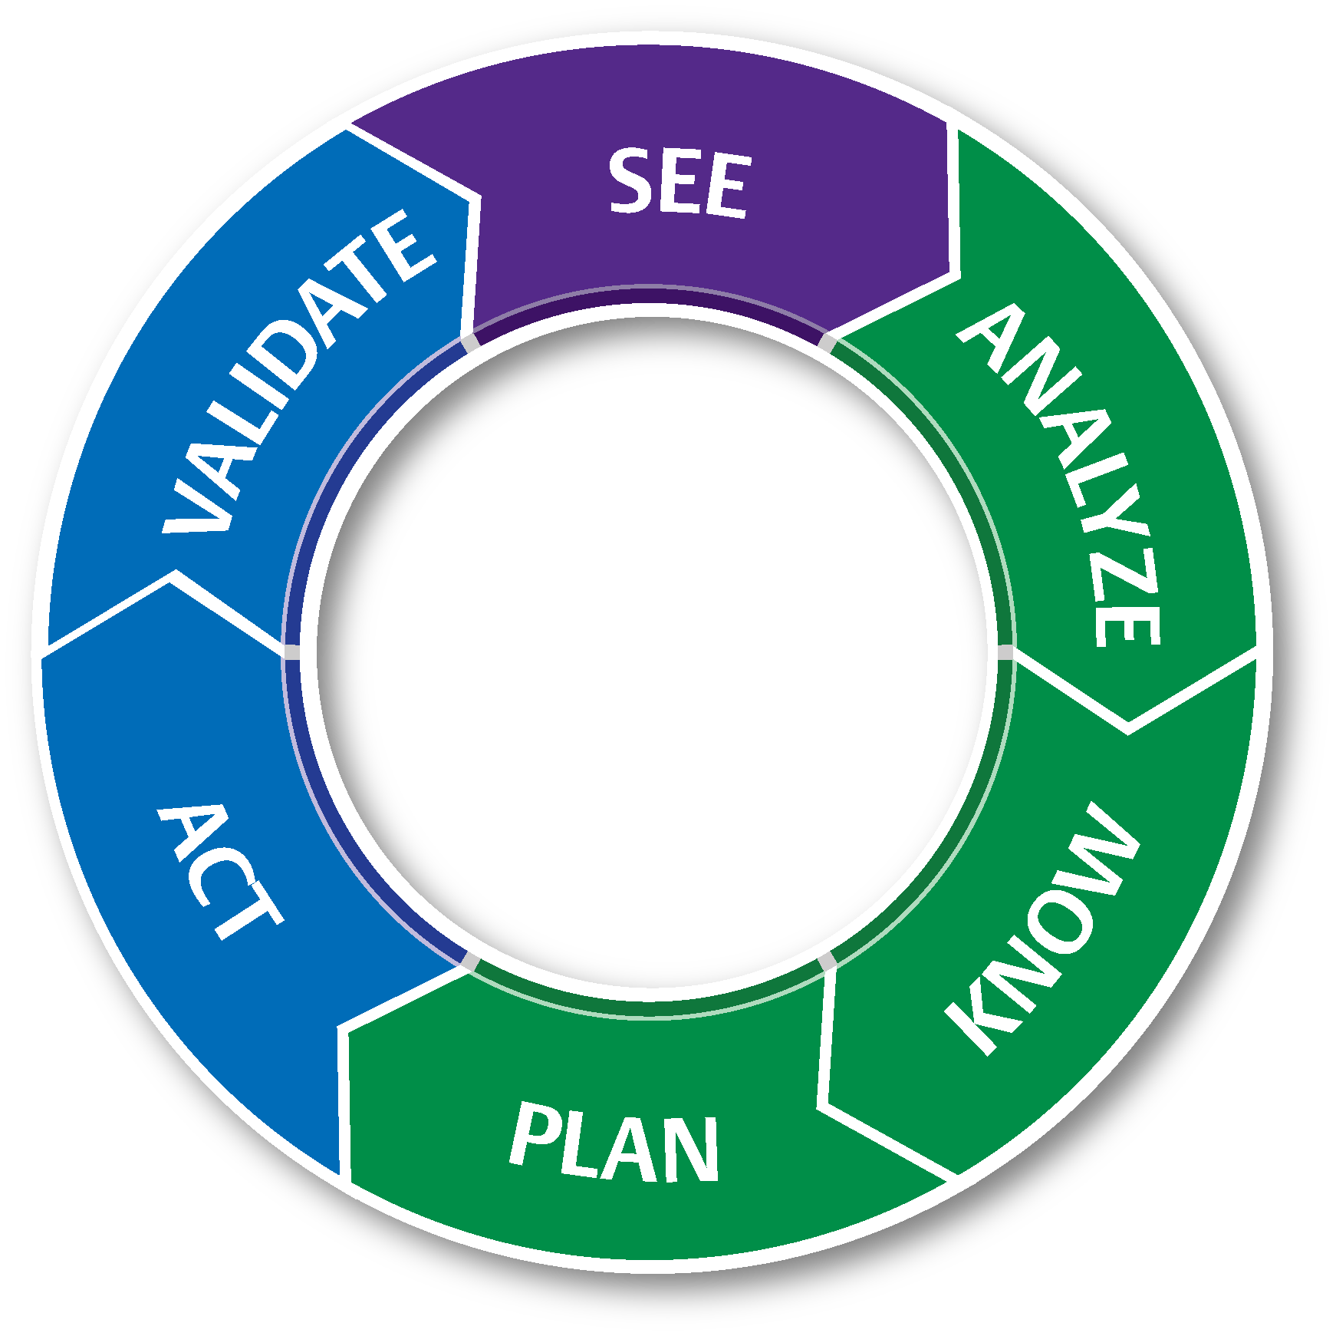
Our Approach to Data Center Infrastructure Management
SEE
DECIDE
ACT
Space
Power
Cooling
10

Slide 11
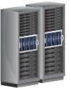
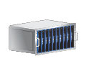
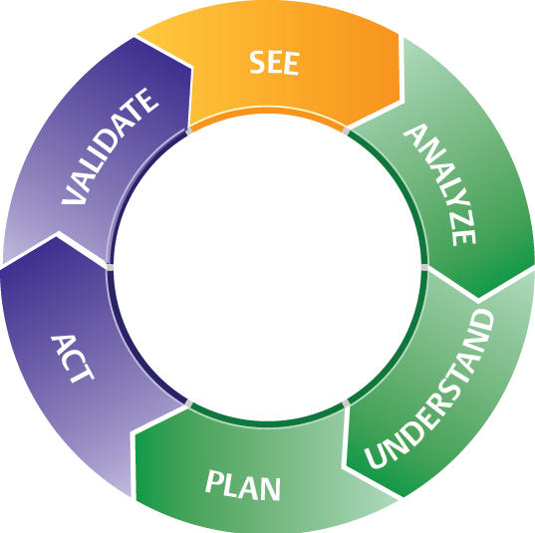
Trellis Platform – The Complete Package
Inventory Manager
Track, Search and Locate Assets
Change Planner
Plan, Understand and Schedule Changes
Site Manager
See, Manage and Monitor Devices
SEE
Energy Insight
View, Monitor and Manage Consumption
DECIDE
ACT
Power System Manager
Track, Understand and Respond Quickly
Virtual Integration Manager
Identify and Access Virtual Sprawl
Cooling System Manager
Recognize Available and Stranded Capacity
Process Manager
Improve and Enhance Workflow; Governance
Scenario Planner
Evaluate, Identify and Calculate Resources
11

