Slide 1
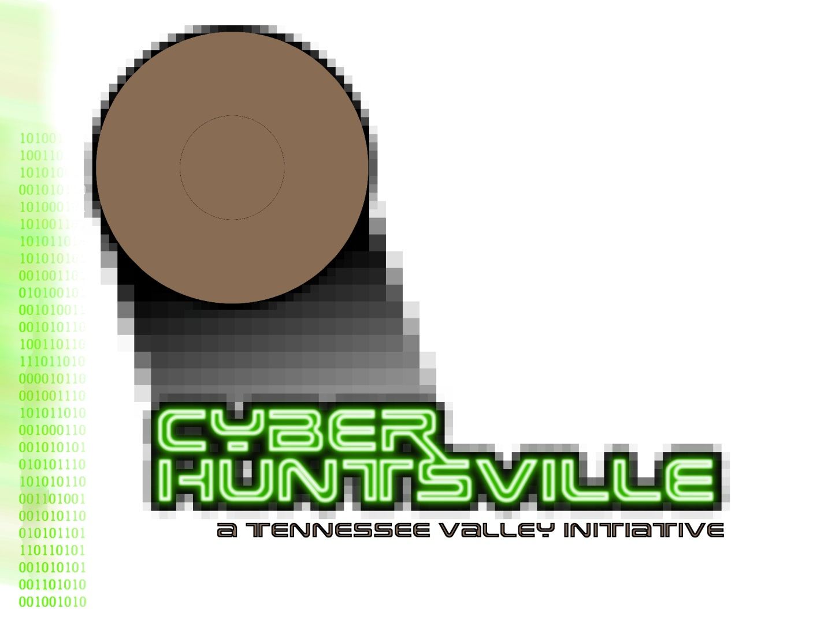
Cyber Huntsville
Briefing to
Energy Huntsville Forum
16 August 2012
Rodney L. Robertson, Ph.D.
President, Cyber Huntsville Initiative
rlrobert@auburn.edu
256-327-3158
Notes:
I have been wanting to come see you to tell you about Cyber Huntsville. Jay has been in to see your staff, as well as the AMC G-5 and G-2, but we’ve been especially eager to come see you, and I thank you for making the time for this visit.

Slide 2
Cyber Huntsville Mission
Serve as an Advocate for the Tennessee Valley Region as a Cyber Center of Excellence
Serve as a Coordinator and Integrator for cyber activities and information across the Tennessee Valley Region
Communicate Cyber Information to the Tennessee Valley Region
Serve as a Catalyst to Initiate and Build World Class Cyber Capabilities in the Tennessee Valley Region
Contribute To Building Cyber Resiliency in Huntsville, Redstone Arsenal, And The Systems And Projects That Are Managed In The Huntsville Area
A Nationally And Internationally Recognized Cyber Leader That
Serves DoD, Other Federal Agencies, And Commercial Markets
Notes:
Huntsville is a unique place, and they didn’t name us one of the country’s geekiest cities for no reason. We arguably have the best systems engineering capabilities in the world. We also have the highest concentrations of engineers and scientists in the country. It is these people that make Huntsville a terrific place to build a world-class cyber capability. Huntsville also has a unique culture of collaboration, and that is what Cyber Huntsville is about—bringing together all Government, all industry, and all academia of the Tennessee Valley to solve some extremely tough challenges in the area of cyber. We have better building blocks than any other place for development of a cyber center of excellence with global reputation and global reach, and we are moving out on that quest. As you can see, our mission leverages our inherent strengths.

Slide 3
Why Cyber Huntsville
Large Cleared Workforce Capable Of Immediately Helping Our Nation Mitigate It’s Most Pressing Threat
Unmatched Systems Engineering Talent
Redstone Arsenal
Home To Over 55 Federal Organizations
Over 30,000 Federal Employees
Home For The Development Of Army Space, Missile, And Aviation Systems
Army Material Command Headquarters
World Wide Army Logistics
NASA
International Space Station Payload Operations Center
Cummings Research Park
Critical Part Of The High-tech Huntsville Community That Provides Key Support To Redstone Arsenal
2nd Largest Research And technology Park In The US
4th Largest Research Park In The World
Largest Per-capita concentration Of Engineers In The Nation

Slide 4
Benefits of Cyber Huntsville
Government
Integral Part Of National Cyber Infrastructure
Expansion Of Cyber RDT&E Capabilities
Improved Cyber Solutions
Value to the Community
Creation Of Local Jobs
Influx Of Cyber Talent
Diversification Of Community Capabilities And Business Base
Enhancement Of Workforce
Collaboration
Academia
Enhanced Competitive Position
Careers For Graduates
Industry
Enhanced Capabilities
Better Access To Opportunities
Cyber Huntsville: Build on Huntsville’s Nationally-recognized Talent Pool And Experience, with Focus On Cyber R&D, M&S, Engineering, T&E And Experimentation
Notes:
We have been very successful in getting members of Government, industry, and academia on board with Cyber Huntsville. Besides recognizing the inherent goodness of collaboration, they also recognize that there is other value for each of their organizations. Some of that value is seen on this chart. One of the biggest benefits of Cyber Huntsville is diversifying Huntsville’s business portfolio. As you know, Huntsville has been able to retain its AAA bond rating. Amongst other things, Cyber will help strengthen our position and help us retain that top rating in the future.

Slide 5
Cyber Huntsville Accomplishments (1 of 4)
Organized The Community In The Cyber Security Mission Area
Branded Cyber Huntsville
Raised The Level Of Awareness And Attention That Is Focused On Cyber Security Within The Tennessee Valley Region
Raised The Level Of Awareness Of The Cyber Security Capabilities And Expertise That Exist In The Tennessee Valley Region To The National And International Cyber Communities
Notes:
Due to an unbelievably hard-working group of volunteers, we have accomplished a massive amount in the past year. We’ve rallied and educated the local community. We’ve also created an awareness of Cyber Huntsville both nationally and internationally.

Slide 6
Cyber Huntsville Accomplishments (2 of 4)
Developed And Executed a Cyber Security Needs, Requirements, And Capabilities Survey
Held “Resilience of Our Critical Infrastructure and Cyber Security Summit --Lessons Learned After the Disaster” Event With DOE And DHS
Established the 501(C)(6) non-profit Cyber Huntsville Corporation
Coordinated/performed a cyber tabletop exercise
Notes:
We’ve also created a survey that determines our strengths, determines the areas where we need to improve in cyber, and determines the local needs for cyber support. Besides the developing the survey, we also co-sponsored a 300-person Cyber Security Summit with the Information Systems Security Association and Infragard (a collaborative group of citizens and the Federal Bureau of Investigations). We had lots of great speakers who helped us broaden our cyber knowledge.
On June 28th, we hosted VIPs from Department of Energy at the Undersecretary level and Department of Homeland Security at the Director level for a summit we called “Resilience of Our Critical Infrastructure and Cyber Security Summit --Lessons Learned After the Disaster” . The point of this summit was to get DOE’s and DHS’ support for building a template for a more robust infrastructure. We showed them all of the damage that the April tornadoes caused, and convinced them we need to be more prepared next time. We also convinced them that the large-scale power outage we had could be caused by cyber attack just as it was caused by tornadoes. Lastly, as I mentioned, we created a non-profit legal entity, complete with Officers and Board of Directors. The 501(C)(6) non-profit allows Cyber Huntsville to manage money, both money collected from conference attendees, as well as grant and other money.
The tabletop exercise was to improve regional cyber resiliency and collective response resulting from a large-scale cyber disruption. We will also be ramping up the Cyber Security Summit, which will be bigger than ever in 2012.

Slide 7
Cyber Huntsville Accomplishments (3 of 4)
Co-sponsored the Annual Cyber Security Summit on 7 June with the North Alabama Chapter of Information Systems Security Association
Expanded to both management and technical tracks, with nationally-recognized speakers
Grew the event from approx. 325 attendees last year to approx. 550 attendees this year

Slide 8
Cyber Huntsville Accomplishments (4 of 4)
Serve as the lead for Cyber on the Chamber of Commerce’s Technology Committee
October Technology Summit
Coordinates with the Government Cyber IPT lead
Initiates and leads Cyber Stem activities for the Huntsville area
Holds quarterly cyber security information meetings
Developed plans for a cyber security R&D facility
Notes:
We’ve also created a survey that determines our strengths, determines the areas where we need to improve in cyber, and determines the local needs for cyber support. Besides the developing the survey, we also co-sponsored a 300-person Cyber Security Summit with the Information Systems Security Association and Infragard (a collaborative group of citizens and the Federal Bureau of Investigations). We had lots of great speakers who helped us broaden our cyber knowledge.
On June 28th, we hosted VIPs from Department of Energy at the Undersecretary level and Department of Homeland Security at the Director level for a summit we called “Resilience of Our Critical Infrastructure and Cyber Security Summit --Lessons Learned After the Disaster” . The point of this summit was to get DOE’s and DHS’ support for building a template for a more robust infrastructure. We showed them all of the damage that the April tornadoes caused, and convinced them we need to be more prepared next time. We also convinced them that the large-scale power outage we had could be caused by cyber attack just as it was caused by tornadoes. Lastly, as I mentioned, we created a non-profit legal entity, complete with Officers and Board of Directors. The 501(C)(6) non-profit allows Cyber Huntsville to manage money, both money collected from conference attendees, as well as grant and other money.
The tabletop exercise was to improve regional cyber resiliency and collective response resulting from a large-scale cyber disruption. We will also be ramping up the Cyber Security Summit, which will be bigger than ever in 2012.

Slide 9
Conclusion
Cyber Huntsville brings together Government, industry, and academia in the Tennessee Valley region to build synergy in the cyber mission area
Cyber Huntsville is making progress in having Huntsville recognized as a critical part of the nation’s cyber solution set
Notes:
In conclusion, the synergy that we are developing with Cyber Huntsville is truly amazing. Huntsville is well on its way to becoming a national-level asset.

Slide 10
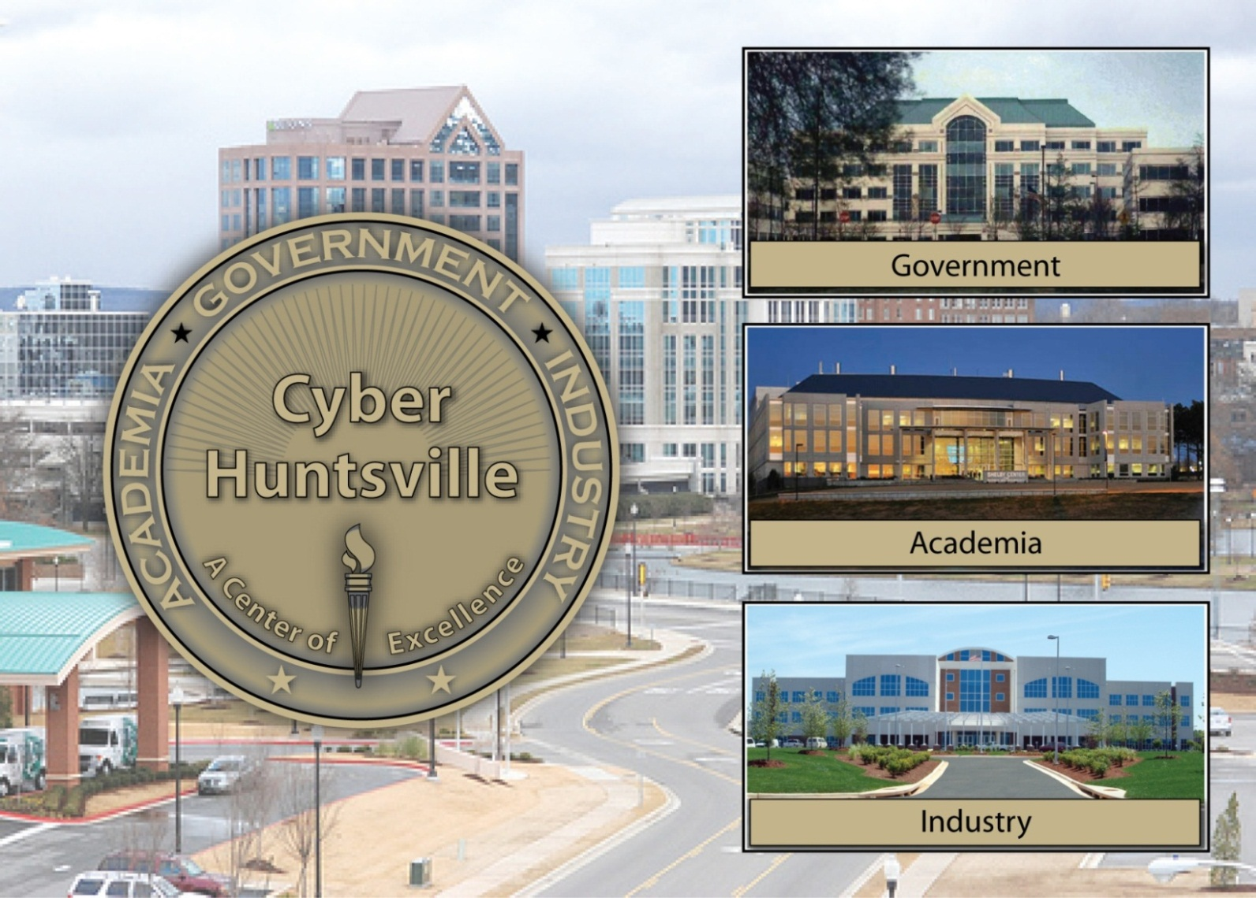
Questions???
For more information visit www.huntsvilleal.gov/cyber
Notes:
We look forward to an on-going dialog, and additional information can be seen at www.huntsvilleal.gov/cyber.

